Slide 1
Introduction to Reliability Engineering
Unit 7a
Fall 2021

Slide 2
References
Ebeling, C.E., Introduction to Reliability and Maintainability Engineering, 2nd ed, Waveland Press, 2019, Chapter 1, 2 (Ebeling, 2019)
Modarres, M., M. Kaminskiy, V. Krivtsov, Reliability Engineering and Risk Analysis, 2nd ed, Taylor & Francis, 2010 (Modarres, RERA)
Jordaan, Ian, Decisions Under Uncertainty– Probabilistic Analysis for Engineering Decisions, Cambridge University Press, 2005 (Jordaan, 2005)
Modarres, M., Risk Analysis in Engineering, Taylor&Francis, 2006 (Modarres, RAE)
Modarres, M., Reliability Engineering and Risk Analysis in Engineering, Marcel Dekker, 1999 (Modarres, RE)
O’Connor, P.D.T., Practical Reliability Engineering, 4th ed, Wiley, 2002 (O’Connor, PRE)
Rausand, M. and Hoyland, A., System Reliability Theory, 2nd edition, Wiley, 2004

Slide 3
Things Fail! Consider Causes
1978 - Ford Pinto was recalled for modifications to the fuel tank to reduce fuel leakage and fires resulting from rear-end collisions. Numerous reported deaths, lawsuits, and the negative publicity eventually contributed to discontinued production of the Pinto.
Faulty design
1979 - The left engine of a DC-10 broke away from the aircraft during take-off killing 271 people.
Poor maintenance procedures, engine removal procedures introduced unacceptable stresses on the pylons.
1979 - The Three Mile Island disaster resulted in a partial meltdown of a nuclear reactor
Cooling water flow to reactor failed. Backup system was down for routine maintenance. Warning lights were hidden by maintenance tags. Emergency relief valve failed to close causing additional water to be lost from the cooling system. Operators were reading gauges that were not working properly. Result of both mechanical and human error and organizational factors.

Slide 4
More Things Fail!
1986 - Explosion of the space shuttle Challenger
The below freezing temperatures prior to launch contributed to the failure by making the rubber O-rings brittle, which failed to seal four sections of booster rocket. Also, failure to investigate and learn from Near Misses.
2003 - Space Shuttle Columbia disintegrated during re-entry into Earth's atmosphere, loss of all 7 crew members
Loss was a result of damage sustained during launch when a piece of foam insulation the size of a small briefcase broke off the Space Shuttle external tank under the aerodynamic forces of launch. Also, failure to investigate and learn from Near Misses.
2007 - The entire span of the Interstate 35W bridge collapsed where the freeway crosses the river in Minneapolis.
Failure of undersized, steel gusset plates was reason for collapse. Engineers who designed the bridge in the 1960s either failed to properly calculate the thickness needed for the plates that were to hold the bridge together. Faulty Design, failure to inspect and repair bridge

Slide 5
Incidents still keep happening!
2009- Macondo Disaster
Blowout preventer failed to shutoff fuel kick
2019- Multiple fire and explosion in fuel storage tank farm at TPC Group, Port Neches
3-day mandatory evacuation, 3 injuries due to pipeline rupture

Slide 6
Why Study Reliability?
Reliability Engineering has grown in importance due to its recognized direct connection with risk:
Profit considerations resulting from the high cost of risk due to failures, their repairs, and warranty programs
Public awareness and insistence on product quality
New laws and regulations concerning product liability
Government requirements to meet Reliability and Maintainability performance specifications
Increased complexity and sophistication of systems requires greater analysis
Notes:
Reliability engineering is a rather recent discipline that has seen significant growth. Several reasons for this popularity and for its importance as a field of study importance are listed above.

Slide 7
Risk, Performance, Cost
Identifying components critical to performance are required for risk analysis. Understanding their performance involves estimating reliability, availability, maintainability.
Risk
Cost
Performance
Engineering decisions involve risk-based synergistic effects and balance among risk, performance, and cost.

Slide 8
Reliability Estimation
Probabilistic
Challenge>Capacity?
Reliability R(t) vs. Maintainability H(t) vs. Availability A(t)

Slide 9
Predicting Reliability: Example
For a new TV unit produced by the XYZ Company, the following distribution of the fraction of units that failed was obtained from a reliability testing program.
Modelling failure behavior to predict Reliability:
Larger fraction of failures initially:
F(t)
Ebeling, 2010

Slide 10
Predicting Reliability: Example
From these data, fraction failed, F(t), was derived as,
where F(t) is the cumulative probability of a TV failure occurring by time t (in operating hours):
Assuming the typical consumer will use the TV an average of 3 hours a day, 1095 operating hours (3 x 365) will be observed for the first year. Therefore, the cumulative probability of a unit failing by t = 1095 hr is
With over ten percent of the units sold expected to fail during the first year, the company decided to initiate a Reliability Growth program to improve product reliability, reduce warranty costs, and increase customer satisfaction.

Slide 11
The Reliability Function
Let random variable T be the time to failure of a component.
Reliability at time T = t is the probability of working up to and at time t.
R(t) is also is the probability of failing AFTER time t designated by R(t) = P(T > t)
Simply stated, Reliability R(t) is the probability that a component or system will survive at least until time t.
Notes:
Some textbooks will refer to the reliability function as the survival function reflecting its medical heritage.

Slide 12
Graph of a Reliability CDF
Three characteristics of an acceptable Reliability distribution, R(t):
Probability of surviving
1. R(T = 0) ~ 0, set = 1, because it is tested and observed to be working
2. Monotonically decreasing
3. R(T ∞) approaches 0
t
Based on this model, R(t), a cumulative distribution function (cdf), is a monotonically decreasing function of time, because the influences that reduce reliability accumulate with time.
Ebeling, 2010
Notes:
The typical reliability function will have a graph similar to the one shown. The function is always monotonically decreasing. Why?

Slide 13
The Failure CDF
Failure distribution: F(t) = 1 – R(t)
F(t) = P(T< t), designated the failure cdf, is the probability of failure by time t.
Because R(t) and F(t) are complementary functions, R(t) + F(t) = 1 for each value of t.
Logic expression:
Notes:
A companion function to the reliability function is the Cumulative Distribution Function (CDF). It gives the probability that a failure will occur by time t. Since a failure must occur either before time t or at or after time t, then F(t) + R(t) = 1 for any value of t. F(t) may be referred to as the failure function.

Slide 14
Graph of a Failure CDF
Three characteristics of an acceptable Failure distribution, F(t):
The probability of a failure
3. approaches 1
2. monotonically increasing
t
Just as R(t) is monotonic decreasing with time, F(t) is a monotonic increasing function of time. As a unit operates in time, the probability of failure increases. .
Ebeling, 2010
Notes:
The CDF will have a graph similar to one shown above. It is a monotonically increasing function. This implies that the longer a component operates, the greater the probability of a failure. The CDF asymptotically approaches one while R(t) asymptotically approaches zero.

Slide 15
Probability Density Function (PDF)
Related to R(t) and F(t) is the failure probability density function (pdf), which is designated by f(t). (Recall pdf and pmf)
Note that f(t) is the slope of F(t) and the slope of -R(t). So f(t) can be derived by taking the first derivative of F(t) or R(t).
Notes:
The PDF when graphed provides the most common representation of the shape of the failure distribution. For example, the graph of the PDF for the normal distribution has the familiar bell-shaped curve. The PDF has two important properties: it is always non-negative and the area under its curve equals one. Given F(t) or R(t), the PDF is easily derived by taking a first derivative.

Slide 16
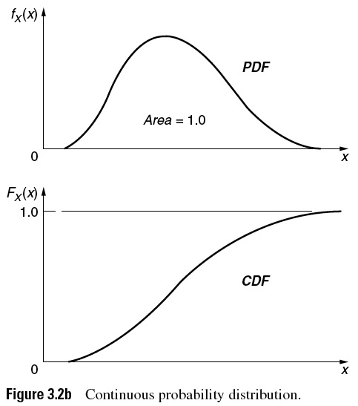
Graph of a Pr Density Function (PDF)
t
The area under a portion of a pdf between t₁= 0 and t₂ is the probability of failure occurring within [t₁= 0, t₂]. This corresponds to a point on the F(t) cdf. The area under the entire pdf equals 1.
Ebeling, 2010
Notes:
The PDF can take on various shapes. The one shown here is only one possibility. It may be skewed or symmetrical. It may be uniform, unimodal, bimodal, or neither. It may be defined over the entire non-negative domain of T or T may have a finite upper bound. In either case, the area under the curve will always equals one and any portion of the area between say, t₁ and t₂, is the probability of a failure occurring within that time interval.

Slide 17
Review: Relationship of PDF and CDF
The cumulative failure and reliability distributions can be derived by integrating the failure pdf.
T = time of failure
F(t) is the probability of a failure up to time t.
T = time of failure
R(t) is the cumulative probability of working at time t and the cumulative probability of failing after time t.
Notes:
If we start with the PDF as given, either the reliability or the failure function can be derived through integration. If the random variable T has a finite upper bound, say b, then R(t) is found by integrating from t to b rather than t to infinity. By the way, a finite upper bound b implies that the component or system must fail by time t = b.

Slide 18
Exercise
Some passive components of a distribution system for natural gas have the following reliability function:
Find: a. R(3 yrs)
b. The CDF, F(t)
c. Pr failure in (1<T<3) = P{1<T<3}
d. The probability density function, f(t)
Ebeling, 2010
Notes:
Work the above example to test your understanding of these concepts. The solution is given on the next slide.

Slide 19
Exercise - Solution
t = 3
t = 1
b. F(t) = 1 – R(t) = 1– [1 - t² / 100] = t² / 100
c. P{1<T<3} = F(3) - F(1) = 0.09 - 0.01 = 0.08
f(t)
10
t
What happens to R(t) and F(t) when t = 10?
Note the limits:
Notes:
If you missed part of this exercise, then go back and review the concepts. If you had difficulty with the mathematics, then you may need to review some algebra or calculus.

Slide 20
Mean Time to Failure (MTTF)
Critical for System Management!
The MTTF is the mean of the pdf failure probability distribution, f(t). MTTF is predicted by either of the following equivalent methods (use the easier method!)
Calculation of the mean time to failure T or expected value of T, E(T), using f(t), the pdf failure distribution, as the weight function for t.
Integration (by parts) of the reliability function R(t) over all T.
Notes:
An important concept in reliability is the Mean Time to Failure (MTTF). This is nothing more than the mean of the failure probability distribution and is found in the same way that any mean or expected value, E[T}, of a random variable is found. For continuous distributions, the mean is defined as the integral of tf(t) integrated over the domain of the random variable. It turns out that the MTTF may also be found by integrating the reliability function over the domain of the random variable as well.

Slide 21
Derivation of MTTF
Integration by parts:
because
Goes to 0 faster than t ∞
Notes:
This derivation makes use of integration by parts. You may fondly recall from your calculus days solving problems using this technique. Do not worry, you will not be asked to replicate this proof. However, you should be able to use the resulting formula. For some distributions, the MTTF is more easily found by integrating R(t) rather than t f(t).

Slide 22
Exercise: MTTF
For the distribution system, find the MTTF using f(t). Given, f(t) = t/50.
Method 1:
Notes:
Here is the same failure distribution as before with its MTTF determined.

Slide 23
Exercise - MTTF Revisited
Method 2:
For the distribution system, find the MTTF using R(t). Begin by finding F(t) from f(t):
Same result as obtained from Method 1.
Notes:
Here is the same failure distribution as before with its MTTF determined.

Slide 24
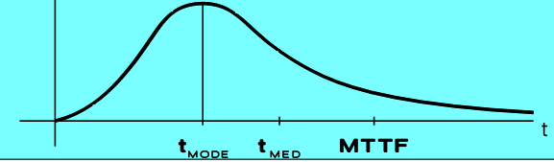
Median Time to Failure
MTTF is a weighted average that is an acceptable point-value representative of time to failure when the distribution is symmetric, such as the Normal distribution, or a fairly symmetric distribution.
Median time to failure is the time for which 50% of the failures occur before the median and 50% occur after the median time to failure.
Median time to failure is an acceptable point value representative of failure times when the distribution is skewed, where the median value is between the mode and the mean.
Pr of failure for T ≥ median
Notes:
The MTTF is a type of weighted average and as such is not always the most representative failure time. The question we are attempting to answer, is what is the most typical time to failure. If the distribution is symmetrical, then the answer may be the MTTF. However, if the distribution is skewed, then another measure of central tendency may be more representative of the entire collection of failure times. The median is often used when distributions are skewed. The median time to failure is that failure time that splits the distribution into two halves where 50 percent of the failures will occur before the median and 50 percent will occur at or after the median time to failure. A third measure of central tendency is the mode or the most likely failure time. It is defined mathematically as the value of t that maximizes f(t) assuming f(t) is unimodal. For a unimodal function, if a unit interval of time is centered at the mode, then the probability of a failure occurring within that interval of time is greater than any other unit interval. Can you show this graphically?

Slide 25
Most Likely Time to Failure (Mode)
The Mode or most likely time to failure is the value of t that maximizes f(t), providing f(t) pdf has a single peak
An unimodal f(t) (single peak), for any unit interval of time, is centered at the mode, the probability of a failure within that interval is greater than in any other unit time interval.
In each case of mean, median, or mode for a particular distribution, the most representative point value time to failure point value can be selected based on the Skewness and Peakedness (Kurtosis) shape of the distribution and the application.
Notes:
The MTTF is a type of weighted average and as such is not always the most representative failure time. The question we are attempting to answer, is what is the most typical time to failure. If the distribution is symmetrical, then the answer may be the MTTF. However, if the distribution is skewed, then another measure of central tendency may be more representative of the entire collection of failure times. The median is often used when distributions are skewed. The median time to failure is that failure time that splits the distribution into two halves where 50 percent of the failures will occur before the median and 50 percent will occur at or after the median time to failure. A third measure of central tendency is the mode or the most likely failure time. It is defined mathematically as the value of t that maximizes f(t) assuming f(t) is unimodal. For a unimodal function, if a unit interval of time is centered at the mode, then the probability of a failure occurring within that interval of time is greater than any other unit interval. Can you show this graphically?

Slide 26
Exercise: Central Tendency for Skewed Distribution
R(t) = 1 - t² / 100 = 0.5 at the median
Solve for t at the median: F(t) = t² /100 = 0.5
t² = 50 or, t_{median} = 7.07 yr
t_{mean} = 6.67 yr (MTTF calculated before)
f(t)
by inspection
t_{mode} = 10 yr
10
t
So, t_{mean} < t_{median} < t_{mode}
This is an example for a distribution tail skewed to the left, where t_{mean} < t_{median} < t_{mode} and t_{mean} weighted by left-skewed tail.
Notes:
Continuing with the same failure distribution, the median and mode are determined. A mode can occur at an end point of the distribution.

Slide 27
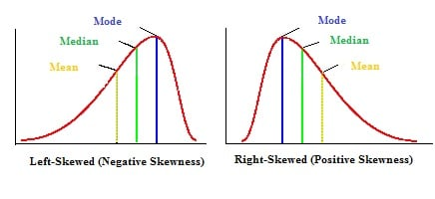
Central Tendency for Skewed Distribution
Central measures for a distribution tail skewed to the right with t_{mode} < t_{median} < t_{mean} and t_{mean} , which is biased by tail to the right.
Central measures for a distribution tail skewed to the right with t_{mode} < t_{median} < t_{mean} and t_{mean} biased by long tail to the right.
Ebeling, 2010
Notes:
For a distribution that is skewed somewhat to the right, the mean (MTTF), median, and mode will typically appear in the relative positions shown.

Slide 28
Design Life
The design life is defined as the time t_{R} that corresponds to a specified reliability value R that we may require for a critical component, where R(t_{R}) = R, where as t increases to time t_{R}, the reliability drops to R(t_{R}).
Example: Find the time, t_{0.99} such that R(t_{0.99}) = 0.99
t_{0.99} is the 0.99 probability or 99 percent design life.
One percent of units are expected to fail by time t_{0.99}
Use probabilistic language for an uncertain event, and do not state “will fail by” as if the event time is known exactly.
Notes:
Using R(t), we can find the reliability at a given time t. The problem can also be worked in reverse. Give a reliability, R, find the corresponding t, call it t_{R}. Then t_{R} is referred to as the design life. That is, it is the length of time that the component can operate at a specified reliability, R.

Slide 29
Variance and Standard Deviation
Variance of t is the weighted average squared difference of a time of failure, t, from the mean time of failure, MTTF, as shown below:
Equivalently by expansion of the above expression, variance is the expected squared time of failure minus the square of the expected time of failure, E(t²)-[E(t)]², as shown in the computational form:
The larger the variance, the less representative the mean, median, or mode central measures, are of the failure time distribution for a component
= mean of square – square of mean
Notes:
A failure distribution has all of the characteristics that any probability distribution has. Therefore is has a variance and standard deviation. The variance may be found using either of the forms shown. Loosely speaking, the variance is the weighted average squared distance a failure is from the MTTF. As such, it is a measure of the dispersion or spread of the failure distribution. The larger the variance, the more dispersed will be the individual failure time from the MTTF. For distributions having a large variance, the mean or median may not be a very representative failure time although it may still, in some sense, provide a “center point” for the distribution.

Slide 30
Exercise - Variance for f(t) = t/50
Coefficient of Variation: unitless Dispersion relative to the Mean
cov = σ/μ = 2.36/44.44 ~ 0.053
Standard deviation, the square root of variance, is useful as a metric of variability in addition to variance, because it has the same units as the random variable.
Notes:
Again with the example, find the variance. The square root of the variance is the standard deviation. The standard deviation is somewhat more useful than the variance since it will be in the same units as the random variable where as the variance is in squared units. If the time to failure is measured in hours, then the standard deviation will be measured in hours and the variance will be measured in hours squared.

Slide 31
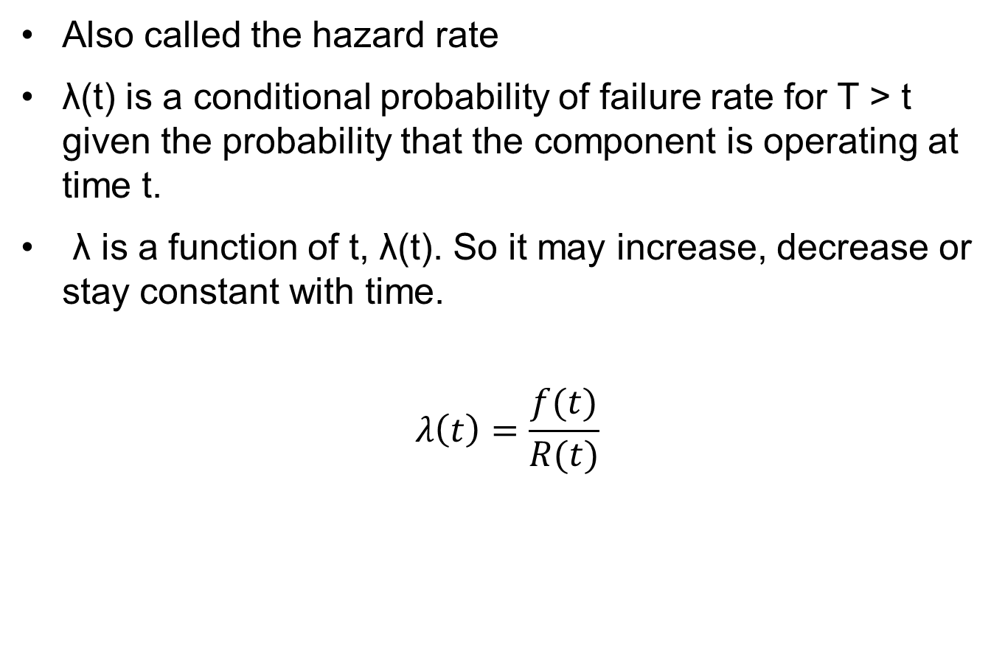
Failure Rate, λ(t)
Also called the hazard rate
λ(t) is a conditional probability of failure rate for T > t given the probability that the component is operating at time t.
λ is a function of t, λ(t). So it may increase, decrease or stay constant with time.
$$λ\left(t\right)=\frac{f(t)}{R(t)}$$

Slide 32
Failure Rate Function (‘Hazard Rate Function’)
From
Obtain
P(T>t)
So
Form λ(t) by dividing by ∆t and taking the limit to dt:
Notes:
The fourth major function of a failure distribution is the hazard rate function. This function is sometimes called the instantaneous failure rate function. It is derived by finding the conditional probability of a failure occurring in small some interval of time given that the component is still operating at the start of the interval. Since the interval may start at any time t, the hazard rate function become a function of time as well and be found by forming the ratio of f(t) / R(t). It is important to understand the meaning of the hazard rate function as a conditional probability.

Slide 33
Failure Rate Function λ(t) from f(t) = t/50
(t)
IFR
Example of a continuously increasing failure rate (IFR) as a component ages
t
10 yr
Note the rapid acceleration of failure rate for t approaching 10 yr.
Notes:
Let us find the hazard rate function for our example. If we plot the hazard rate, we can see that it is monotonically increasing. This suggest that the probability of a failure occurring in the next instant of time is continuously increasing as the component ages. Failure distributions having this characteristic are referred to as having an Increasing Failure Rate (IFR).

Slide 34
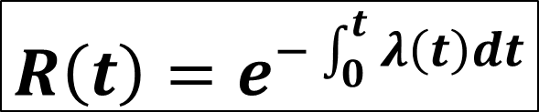
Relation of Failure Rate and Reliability
Begin with λ(t) and derive R(t)
$$R\left(t\right)=e^{−\int_{0}^{t}{λ\left(t\right)dt}}$$
Integrate:
Example: If
Notes:
Given R(t), we can find f(t), and then using f(t) and R(t) derive λ(t). If we start with λ(t), this formula allows us to derive R(t). The next slide shows its derivation. When using this formula, be careful to find the definite integral first and then use the negative of its value as the exponent with e as the base.

Slide 35
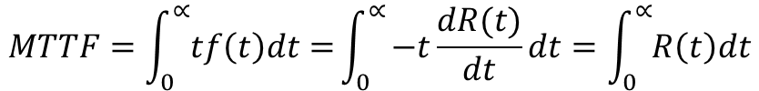
Review
R(t)=Pr(T>t)
F(t) = Pr(T<t) = 1-R(t)
$$MTTF=\int_{0}^{∝}{tf\left(t\right)dt=}\int_{0}^{∝}{−t\frac{dR(t)}{dt}dt=\int_{0}^{∝}{R\left(t\right)dt}}$$

Slide 36
Probability Density Function (PDF)
a
b
Pr of failure between a and b:
P{a$≤T≤b\}=F\left(b\right)−F\left(a\right)=R(a)−R(b)=\int_{a}^{b}{f\left(x\right)dx}$

